Slide 1





Events and Forms
Handling User Interaction
Events
Forms
SoftUni Team
Technical Trainers
Software University
http://softuni.bg

Slide 2

Table of Contents
Handling Events
Managed Forms
State vs. Props
Component Composition

Slide 3
Have a Question?
sli.do #js-web

Slide 4
Handling Events

Slide 5
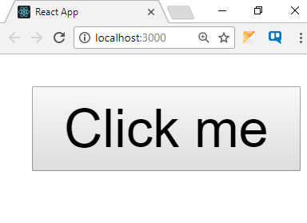
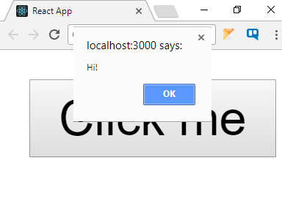
Events in React
React uses synthetic events
Very similar to regular DOM events
Event handling is the same across all browsers in React
function sayHi() {
alert('Hi!');
}
<button onClick={sayHi}>
Hello
</button>
Event names use camel case

Slide 6
Handling DOM Events
Use the HTML event name with camel case
E.g. click → onClick, focus → onFocus, etc.
For a full list, see https://reactjs.org/docs/events.html
There is no need to call addEventListener
If using this inside the listener, you must bind it
Use Function.bind() inside the constructor
Or use an arrow function
Events are pooled – never use them asynchronously!

Slide 7
Handling DOM Events: Example
class Toggle extends React.Component {
constructor(props) {
super(props);
this.state = {isToggleOn: true};
}
handleClick() {
this.setState(prevState => ({isToggleOn: !prevState.isToggleOn}));
}
render() {
return (<button onClick={this.handleClick.bind(this)}>
{this.state.isToggleOn ? 'ON' : 'OFF'}
</button>);
}
}
Event handler
as class method
Bind event listener

Slide 8
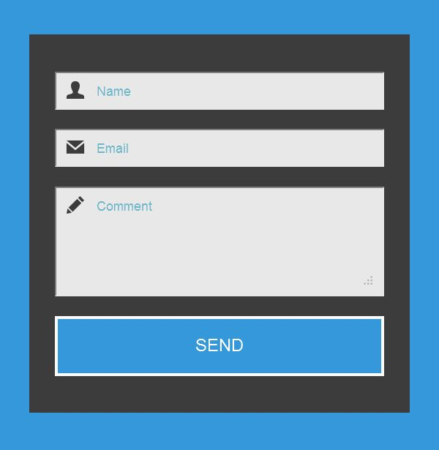
Forms
Reading and Storing User Input

Slide 9
Managed Forms
Form inputs are explicitly managed
The value is stored inside the component state
Input is recorded with event handlers
setState
Name:
Component
Pesho
value:
Pesho
changeHandler
change event

Slide 10
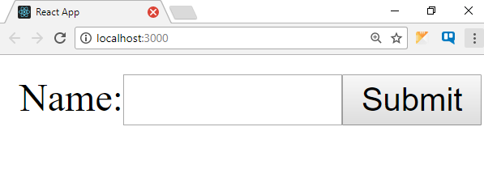
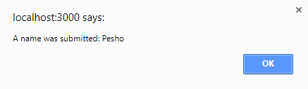
Form Component Declaration
class NameForm extends React.Component {
constructor(props) {
super(props);
this.state = {value: ''};
this.handleChange = this.handleChange.bind(this);
this.handleSubmit = this.handleSubmit.bind(this);
}
handleChange(event) {
this.setState({value: event.target.value});
}
handleSubmit(event) {
alert('A name was submitted: ' + this.state.value);
event.preventDefault();
}
// Continues …
}
Bind event handlers
Pesho

Slide 11
Form Component Rendering
class NameForm extends React.Component {
// Continued …
render() {
return (
<form onSubmit={this.handleSubmit}>
<label>
Name:
<input type="text"
value={this.state.value}
onChange={this.handleChange} />
</label>
<input type="submit" value="Submit" />
</form>
);
}
}
Take value from state
Pesho

Slide 12
Unified Input Approach
React handles all form input elements the same
textarea uses a value prop
select uses a value prop on the root element
Pass an array to select multiple values
<form onSubmit={this.handleSubmit}>
<textarea value={this.state.value} onChange={this.handleChange} />
<input type="submit" value="Submit" />
</form>
<select multiple={ true } value={ ['A', 'B', 'C'] }>

Slide 13


Managed Forms
Live Demo

Slide 14
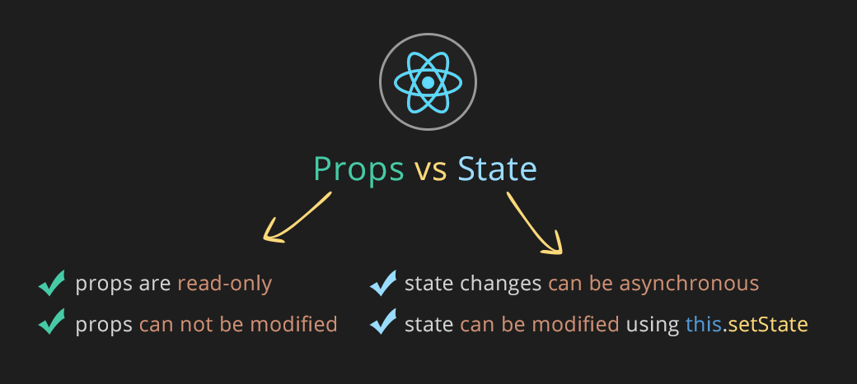
State vs. Props

Slide 15
Managing State
State is internal while props are external
Shared state should be elevated to the parent component
MyComponent
OtherComponent
props:
state:
props:
state:
Shared state
someValue
someValue

Slide 16
Managing State
State is internal while props are external
Shared state should be elevated to the parent component
ParentComponent
Children receive the value as props
state:
someValue
MyComponent
OtherComponent
props:
state:
props:
state:
someValue
someValue

Slide 17
Immutable User Interfaces
The UI doesn't change – it represents the current state
Changes to the state result in a completely new UI
State
Actions
Server
Models
Views
Components

Slide 18
Immutable UI Arguments
Drawbacks:
More boilerplate code
Takes time to get used to
Benefits:
Components are easier to reason about
Easier to find bugs
Business logic is isolated from the view

Slide 19

Component Composition

Slide 20
Composing Lists
Components can be created inside loops
E.g. iterating trough an array of contacts to display a list
We must include a special key property to each item
The diffing algorithm use it when updating collections
Iterate array with a mapping function
<ul>
{this.props.users.map(u => <li key={u._id}>{u.name}</li>)}
</ul>

Slide 21
Composing Components
React components can be nested, like DOM elements
The parent manages state and handles events
The children may not be known ahead of time
E.g. menus and navigation components
NavMenu render
<NavMenu>
<Link to="/somePage" />
<Link to="/otherPage" />
</NavMenu>
<div>
{this.props.children}
</div>

Slide 22
Using PropTypes
Keeping track of data in a large app is hard
Use the PropTypes package for typechecking in React
Use the propTypes property of a component to validate props
Complete list of types: npmjs.com/package/prop-types
npm install prop-types
Greeting.propTypes = { name: PropTypes.string };
Note: for versions prior to v15.5 PropTypes is part of React

Slide 23
Components as View Controllers
Elevating state concentrates data
The component on top acts like a Controller
Tip: avoid long prop lists by using binding models
Composition allows you to reuse code and add behavior
E.g. you can wrap a component in another component to create a "specialized" version
Using inheritance with React is discouraged

Slide 24
Summary
React handles events like regular JS
Forms must be explicitly managed
State should be elevated to a View Controller
<button onClick={() => alert('Hi!')}>
Hello
</button>

Slide 25












Events and Forms
https://softuni.bg/courses/

Slide 26

License
This course (slides, examples, demos, videos, homework, etc.) is licensed under the "Creative Commons Attribution-NonCommercial-ShareAlike 4.0 International" license

Slide 27





Trainings @ Software University (SoftUni)
Software University – High-Quality Education, Profession and Job for Software Developers
softuni.bg
Software University Foundation
http://softuni.foundation/
Software University @ Facebook
facebook.com/SoftwareUniversity
Software University Forums
forum.softuni.bg

